Slide 1
NATIONAL INSTITUTE OF INFORMATION TECHNOLOGY
DIGITAL TRANSFORMATION
PROJECT TITLE:INDOOR GAMES SHOPPING
Submitted by
Vinith kumar R

Slide 2
SYSTEM REQUIREMENTS
Java (version 5.0 or greater)
Memory -1GB or more
Diskspace-1GB or more
Processor speed-1.5Ghz or faster

Slide 3
AIM
To build a INDOOR GAMES SHOPPING- Ecommerce website using eclipse and H2database
SCOPE
The Scope of this project is to sell indoor games products

Slide 4
What is ECLIPSE
Eclipse is a Java-based open source platform that allows a software developer to create a customized development environment from plugin components built by eclipse members

Slide 5
What is H2 DATABASE
H2 is a relational database management system written in Java. It can be embedded in Java applications or run in the client-server mode.
Very fast, open source, JDBC API
Embedded and server modes; in-memory databases

Slide 6
ABSTRACT
Create workspace in Eclipse
Create Maven Project in Eclipse
Select Arche type and assign Groupid and Artifact ID
Add dependencies in POM.xml
Create web.xml and dispatcher Servlet
Write Source code in JSP files and resource location for Jsp files also mentioned
Create a Apache Tomcat server for testing the project

Slide 7
@Request Mapping
Handler Mapping
Request
1
Web.xml
2
3
Landing page
9
Dispatcher Servlet
4
8
Controller
6
7
5
View Resolver

Slide 8
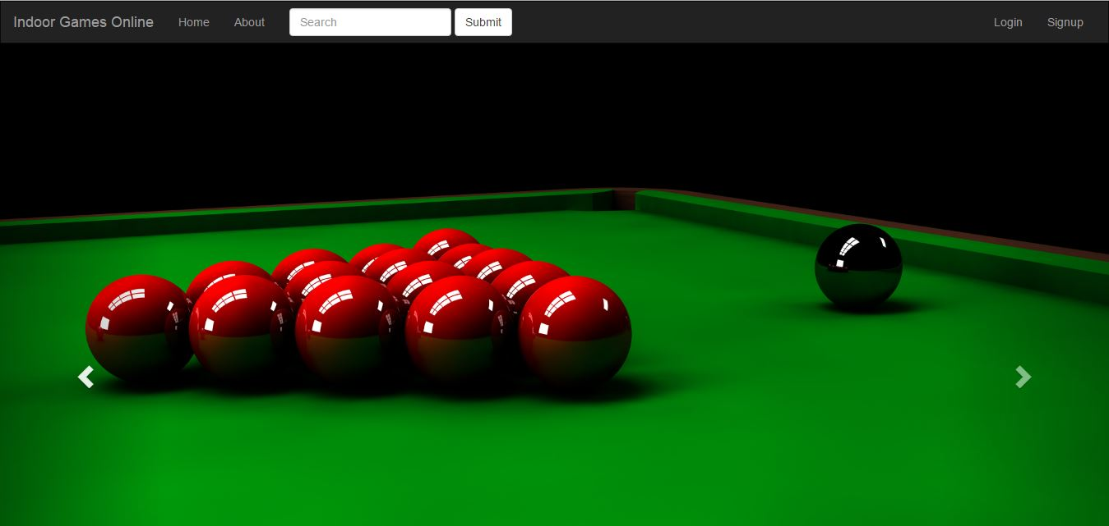
Output

Slide 9
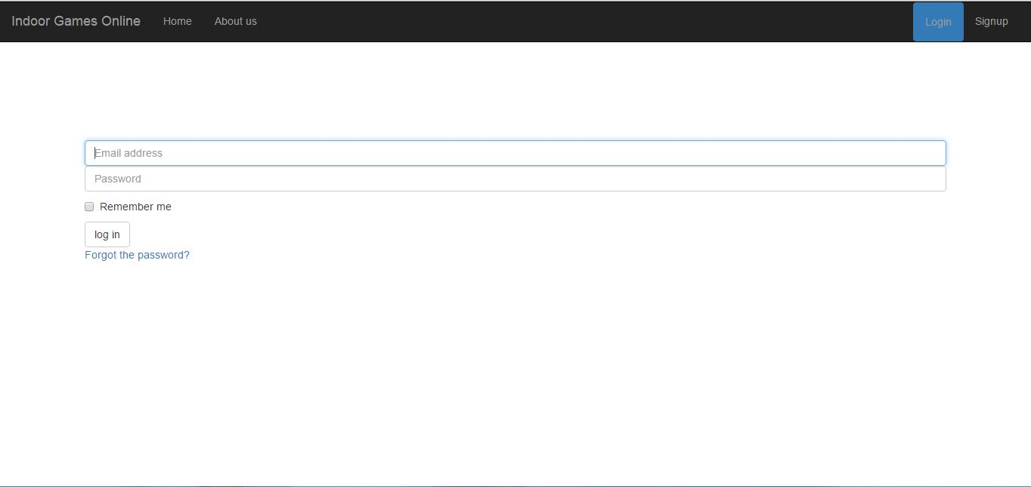

Slide 10
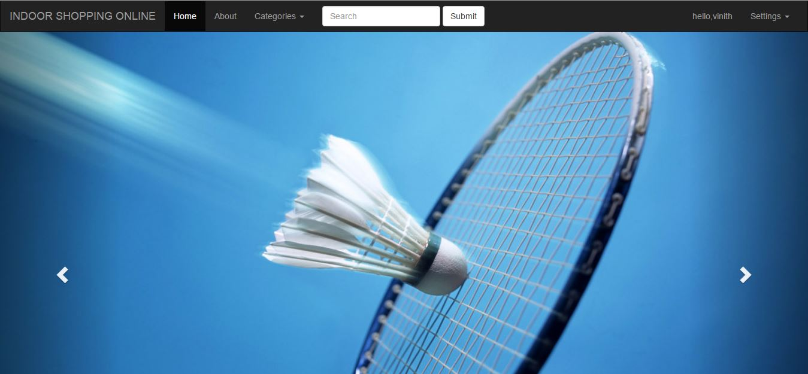

Slide 11
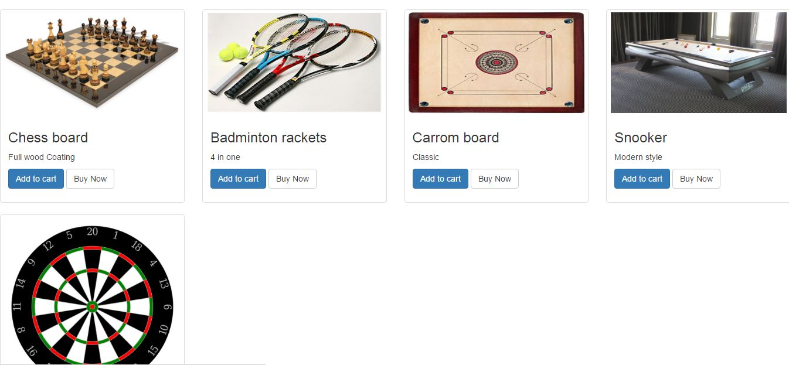

Slide 12
Thank you

